Slide 1
NCDCC Y3 Specialisation Course: Preparation & Notes
By Warrant Officer Nathaniel Dhaliwal

Slide 2
Specialisation Course: overview
4 Spec Courses
Fire Safety
Medical Response
Urban Search and Rescue (USAR)
Marine Fire Rescue
2 Possible Locations
HomeTeam Academy (HTA)
Civil Defence Academy (CDA)
Notes:
Quiz cadets on naming all 4 spec courses, and 2 locations

Slide 3
Admin matters
General things to take note

Slide 4
Reporting
Report EARLY
15-30 minutes before
The earlier the better
Be prepared: bring necessary items
Water bottle
Pen
Notebook
Student card
Medication/Inhaler
Keep phones, watches and wallets in bag
Wear beret when entering HTA or CDA

Slide 5
Behaviour and Decorum
Do NOT misbehave
Always follow the instructions of the CLTs/HOs/AFIs
CLT: Cadet Lieutenant (Sec 5/6/7, Poly/JC/IB/ITE)
HO: Honorary Officer (Adult volunteers)
AFI: Assistant Field Instructor (SCDF Sergeants)
Greet uniformed personnel by rank
“Good morning/afternoon Sir/Ma’am!”
Male officers: Sir; Female officers: Ma’am (NOT ‘Madam’)
If both you and the officer is in headgear, salute.
If an AFI/CLT/HO says ‘Cadets, listen up!’, you must respond with ‘Yes Sir/Ma’am!’
Notes:
After showing the second point, quiz them if they know what CLTs, HOs and AFIs stand for.
Quiz them if they know who the ‘Field Instructor’ then is. Ans: WO2 Kalai Kumar A/L Kuppusamy (Just say WO2 Encik Kalai) and LTA Mohamed Jailani (In DART? [Quiz cadets on what DART is. Ans: Disaster Assistance and Rescue Team; it is very prestigious])
Also, tell them that AFIs are not officers, but instead NCOs (then ask why). Ans: They become WO, not LT/CPT/MAJ etc.

Slide 6






NCDCC ranks
CLT Ranks:
Officer Cadet Trainee
(OCT)
Cadet Lieutenant
(CLT)
Senior Cadet Lieutenant
(SCLT)
HO Ranks:
Officer Cadet Trainee
(OCT)
Lieutenant
(LTA)
Captain
(CPT)
Major
(MAJ)
Image credit: https://efssncdcc.blogspot.com
Notes:
Quiz cadets what the ranks are, and how many. Ans: 3 CLT ranks and 4 HO ranks.
Tell them this fun fact: MAJ is the highest NCDCC rank, and there is MAJ Dr Jason Chen, Head of Corporate Planning (NCDCC): Has a PhD in Integrative Sciences and Engineering.

Slide 7
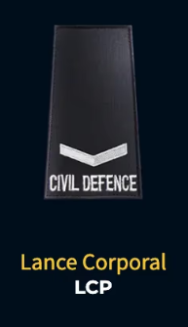
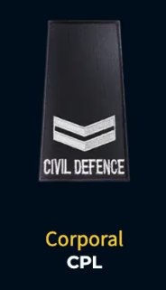
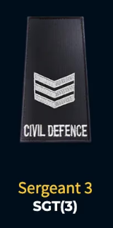
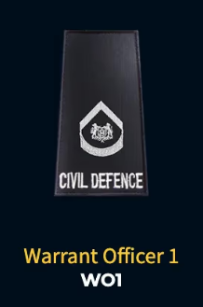
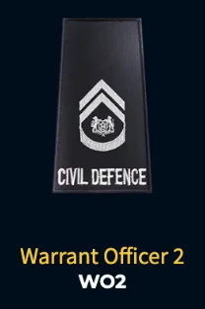
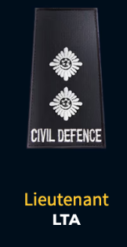
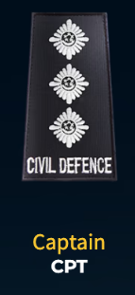
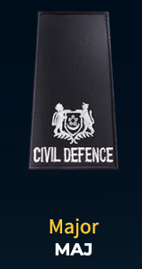
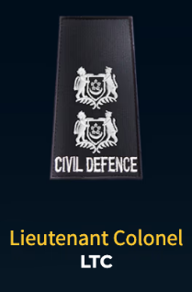
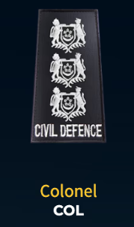
SCDF Ranks
NCO Ranks:
Officer Ranks:
You can call Warrant Officers ‘Encik’
Notes:
Quiz cadets if they know what NCO is. 11 NCO ranks and 12 Officer ranks.
NCO Ranks: REC, PTE, LCP, CPL, Specialist Cadet (Junior Term), Specialist Cadet (Senior Term), SGT1, SGT2, SGT3, WO1, WO2
Officer Ranks: OCT (Junior Term), OCT (Senior Term), 2LT, LTA, CPT, MAJ, LTC, COL, Asst. Commr, Senior Asst. Commr, Dep. Commr, Commr.
Also, tell cadets that well-performing WOs can be promoted to be an officer.

Slide 8
Rank notes
Highest NCDCC rank (MAJ) is still lower than SCDF ranks.
Hierarchy of ranks:
SCDF NCOs/AFIs (SGT-WO)
NCDCC HOs (LTA-MAJ)
NCDCC CLTs (CLT-SCLT)
NCDCC Cadets (PTE-WO)
SCDF Officers (LTA-COMR)

Slide 9
Procedures
When entering a room, do NOT sit down immediately
Ask for permission to sit
When entering a room, and are wearing your beret, do NOT take off your beret
Ask for permission to take off your beret
Be smart: combine requests
Optional: If you want to be very by-the-book, sitting down will automatically be sitting in DIAM; you need to ask permission to sit at ease
This is rarely practiced, but if they do, be prepared!
Notes:
Say that you can combine requests (i.e. to ‘sit down and take off beret’)
Also, give an analogy: Encik Kalai, LTA Naufal Taufiq Bin Suhaimi (NCDCC) [HO, but don’t tell cadets] and LTA Mohamed Jailani are in the room, who do you ask permission from? Ans: LTA Mohamed Jailani, as he is an officer and Encik Kalai is not.

Slide 10
uniform
Turnout and bearing notes

Slide 11
Types of uniform
How many types of uniform are there?
Technically, 4 main types, but they can branch out further
No. 1: Formal parade attire (White coloured with gold buttons and epaulettes)
No. 2: PT kit (PE attire)
No. 3: Working attire (for NCDCC & SCDF, it is black coloured with gold buttons)
No. 4: Smart 4
Smart 4 (with badges)
Training 4 (without badges)
Half-U (no field jacket)
Notes:
Quiz cadets on how many main types of uniform there are, and describe each one (there are 4: No. 1, 2, 3, 4)

Slide 12
Smart 4 notes
Field jacket
Sleeves should be 7 fingers from shoulder seam
Starch collars & top button closed
Pin badges in a straight line
Field pants
Starch pants line down the middle
Flatten side Velcro pockets
Belt
Push clips to the front
Beret
SEASON BERET
Create a fold behind the crest to slope the beret down
Notes:
Demonstrate how to create the beret fold/crease.

Slide 13
Appearance
Cut hair short
School cut, or shorter
Cut nails short
Clean nails, no dirt
Trim facial hair
No jewellery/accessories
No dyed hair

Slide 14
Drills
Basic drills and procedure that you need to know

Slide 15
Muster Parade
Done at the start & end of the day
Purpose: To take strength of cadets
Drills required: Footdrill Bronze
SEDIA
SENANG-DIRI
KE KANAN LURUSDARI KIRI/KANAN/TENGAH, CEPAT JALAN
HORMAT KE HADAPAN, HORMAT
KE KANAN/KIRI/BELAKANG PUSING
PANGGIL NAMA (Not in FD Bronze/Silver/Gold, but will be used for Muster Parade)
KIRI/KANAN BELOK (FD Gold, but will be used: just turn 90° to the left/right; no timing)
Notes:
Quiz them if they know what the purpose is.
Ask them if they know how to conduct Muster Parade as a Parade IC and as a Rota IC. If either is a no, brief them on the Muster Parade slides after this presentation.

Slide 16
Water Parade
Done at the start of the day
Purpose: To hydrate yourself
Reciting the NCDCC Core Values
N: Noble
C: Caring
D: Disciplined
C: Courageous
C: Committed
Ask permission from highest-ranking officer to drink up
Notes:
Quiz them if they know what the purpose is, as well as what the 5 NCDCC Core Values are.

Slide 17
FD Bronze & Silver
You will need to know FD Bronze and Silver drills, including:
MAJU
HENTAK KAKI, HENTAK (NOT HENTAK KAKI CEPAT, HENTAK)
T-L-V (KE BELAKANG PUSING on a march)
Marching
KIRI/KANAN BELOK (FD Gold, but will be used: just turn 90° to the left/right; no timing)
Other FD Bronze (Basic) drills
Footdrills (especially marching) are a part of the course
Other drills good to know:
IMPIT KIRI/KANAN (shift left/right while marching to avoid obstacles; no timing)

Slide 18
Locations
Diagrams of where key locations in HTA and CDA are

Slide 19
Moving Between Venues
Indoors/wet weather
Walk, don’t run
Stay in 1 line
Beret should be taken off when indoors
Ask permission to do so if you are entering a room with your beret on
Outdoors
March between locations
Beware of vehicles, if any
Stay on timing
KIRI/KANAN BELOK when needed

Slide 20
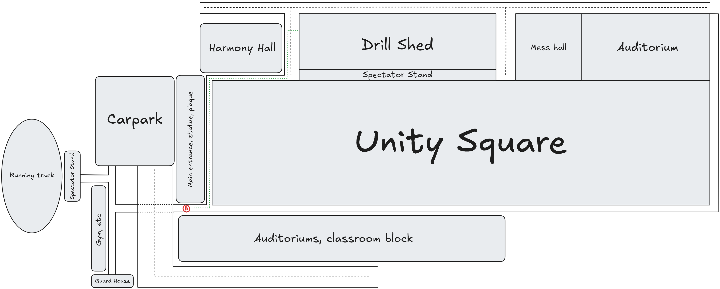
HTA Map
(A) → Fall-in point
Green line → Marching route

Slide 21
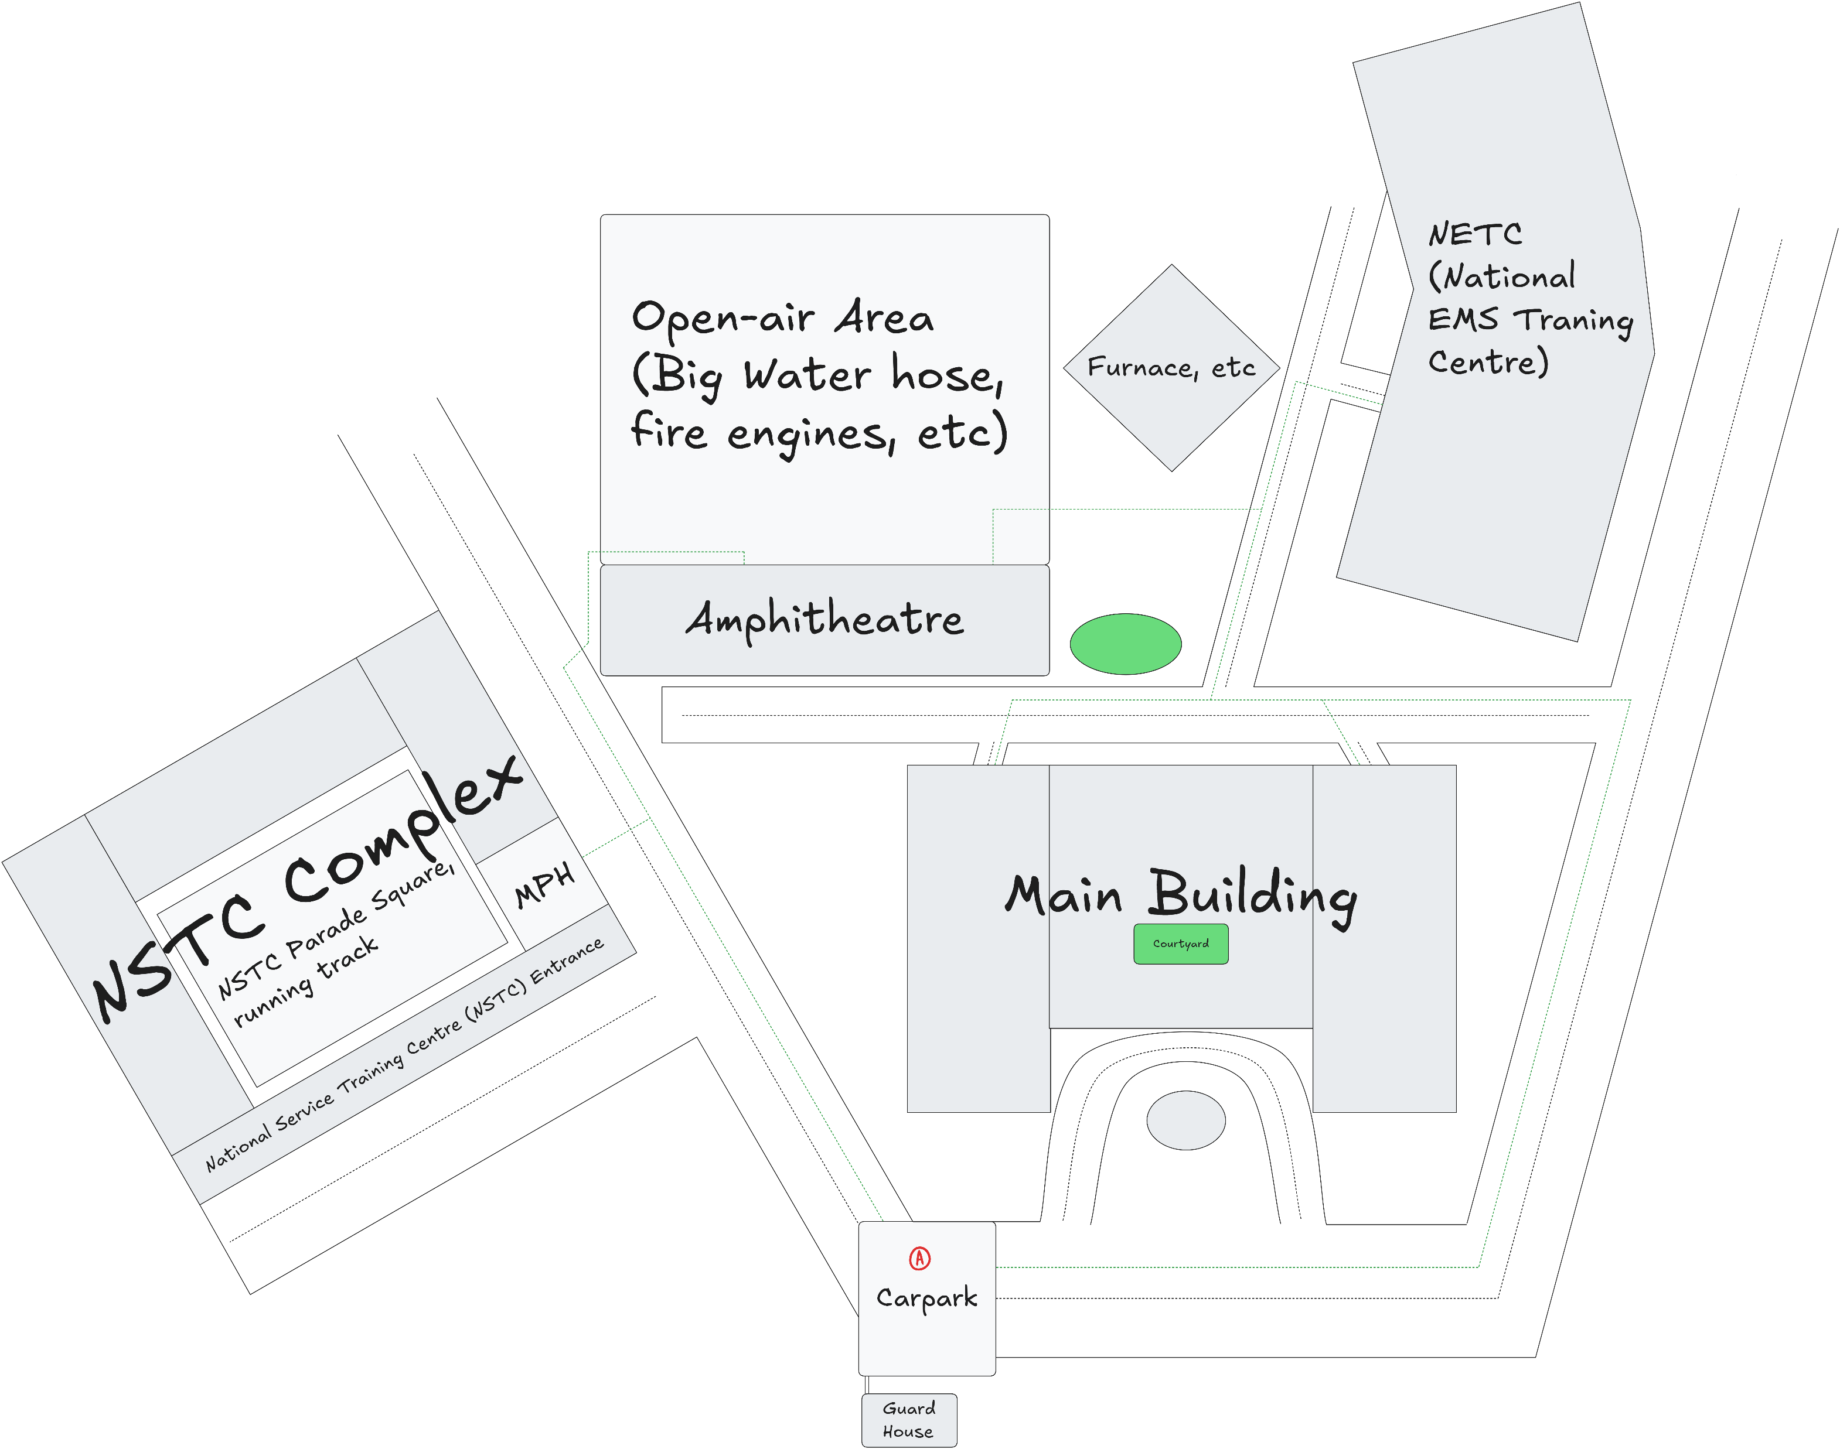
CDA Map
(A) → Fall-in point
Green line → Marching route

Slide 22
Good Luck!

